Slide 1
Altering Data Structures and Data
Alter, Update, Delete

Slide 2
Dropping a Table
All data and structure in the table are deleted.
Any pending transactions are committed.
All indexes are dropped.
All constraints are dropped.
You cannot roll back the DROP TABLE statement.
DROP TABLE MM_game CASCADE CONSTRAINTS PURGE;
Table dropped.
Notes:
Dropping a Table
The DROP TABLE statement removes the definition of an Oracle table. When you drop a table, the database loses all the data in the table and all the indexes associated with it.
Syntax
DROP TABLE table
In the syntax, table is the name of the table.
Guidelines
All data is deleted from the table.
Any views and synonyms remain but are invalid.
Any pending transactions are committed.
Only the creator of the table or a user with the DROP ANY TABLE privilege can remove a table.
Note: The DROP TABLE statement, once executed, is irreversible. The Oracle server does not question the action when you issue the DROP TABLE statement. If you own that table or have a high-level privilege, then the table is immediately removed. As with all DDL statements, DROP TABLE is committed automatically.

Slide 3
CASCADE CONSTRAINTS
Specify CASCADE CONSTRAINTS to drop all referential integrity constraints that refer to primary and unique keys in the dropped table.
If you omit this clause, and such constraints exist, then the DBMS will return an error and will not drop the table.

Slide 4
PURGE
Specify PURGE if you want to drop the table and release the space associated with it in a single step.
If you specify PURGE, then the database does not place the table and its dependent objects into the recycle bin.

Slide 5
FOREIGN KEY Constraint: Keywords
FOREIGN KEY: Defines the column in the child table at the table-constraint level
REFERENCES: Identifies the table and column in the parent table
ON DELETE CASCADE: Deletes the dependent rows in the child table when a row in the parent table is deleted
ON DELETE SET NULL: Converts dependent foreign key values to null
Notes:
FOREIGN KEY Constraint: Keywords
The foreign key is defined in the child table, and the table containing the referenced column is the parent table. The foreign key is defined using a combination of the following keywords:
FOREIGN KEY is used to define the column in the child table at the table-constraint level.
REFERENCES identifies the table and column in the parent table.
ON DELETE CASCADE indicates that when the row in the parent table is deleted, the dependent rows in the child table are also deleted.
ON DELETE SET NULL converts foreign key values to null when the parent value is removed.
The default behavior is called the restrict rule, which disallows the update or deletion of referenced data.
Without the ON DELETE CASCADE or the ON DELETE SET NULL options, the row in the parent table cannot be deleted if it is referenced in the child table.

Slide 6
ALTER TABLE Statement
Use the ALTER TABLE statement to:
Add a new column
Modify an existing column
Define a default value for the new column
Drop a column
Notes:
ALTER TABLE Statement
After you create a table, you may need to change the table structure for any of the following reasons:
You omitted a column.
Your column definition needs to be changed.
You need to remove columns.
You can do this by using the ALTER TABLE statement. For information about the ALTER TABLE statement, see the Oracle Database 10g SQL Fundamentals II course.

Slide 7
Adding column(s) to a table
To add a column to an existing table:
ALTER TABLE table_name ADD column_name column-definition;

Slide 8
Adding column(s) to a table
We are going to add a column game_cert to the mm_game table and use this to set the certification for each game e.g. PG, 12A, 18 etc
ALTER TABLE MM_game
ADD game_cert VARCHAR2(30);
This will add a column called game_cert of type varchar2(30) to the MM_game table.
Name Null Type
------------- -------- ------------
game_ID NOT NULL NUMBER(4)
game_TITLE VARCHAR2(40)
game_TYPE_ID NOT NULL NUMBER(2)
game_PRICE NUMBER(5,2)
game_QTY NUMBER(2)
game_CERT VARCHAR2(30)

Slide 9
Adding column(s) to a table
To add multiple columns to an existing table:
ALTER TABLE table_name
ADD (column_1 column-definition,
column_2 column-definition,...
column_n column_definition );
For example:
ALTER TABLE MM_game ADD (game_cert VARCHAR2(30), game_designer VARCHAR2(50));
This will add two columns (game_cert, game_designer) to the mm_game table.

Slide 10
Modifying column(s) in a table
To modify a column in an existing table:
ALTER TABLE table_name MODIFY column_name column_type;
For example:
ALTER TABLE MM_game
MODIFY game_TITLE VARCHAR2(100) NOT NULL;
This will modify the column called game_TITLE in the MM_game table to be a data type of varchar2(100) and force the column to not allow null values.

Slide 11
Modifying column(s) in a table
To modify multiple columns in an existing table:
ALTER TABLE table_name MODIFY (column_1 column_type, column_2 column_type,... column_n column_type );
For example:
ALTER TABLE MM_game
MODIFY (game_TITLE VARCHAR2(100) NULL, game_PRICE NUMBER(6,2) NOT NULL);

Slide 12
Modifying Null/Not Null
ALTER TABLE MM_game
MODIFY game_PRICE NULL;

Slide 13
Drop column(s) in a table
To drop or remove a column in an existing table:
ALTER TABLE table_name DROP COLUMN column_name;
For example:
ALTER TABLE MM_game
DROP COLUMN game_CERT;
This will drop the column called game_CERT from the table MM_game

Slide 14
Rename column(s) in a table
To rename a column in an existing table:
ALTER TABLE table_name RENAME COLUMN old_name to new_name;
For example:
ALTER TABLE MM_game
RENAME COLUMN game_QTY TO game_QUANTITY;
This will rename the column called game_QTY in MM_game to game_QUANTITY.

Slide 15
ALTERING constraints
To use ALTER to change constraints, you may:
Add a constraint
Drop a constraint
Enable a constraint
This happens automatically when the constraint is added.
Disable a constraint
May need to do this sometimes to manage inserts/updates without enforcing table order

Slide 16
Altering to add constraints
ALTER TABLE table_name ADD CONSTRAINT constraint_name CHECK (column_name condition);
E.g.
ALTER TABLE MM_game
ADD CONSTRAINT chk_game_price check (game_PRICE between 1.00 and 100.00);

Slide 17
Altering to add constraints
ALTER TABLE table_name ADD CONSTRAINT constraint_name UNIQUE (column_name condition);
E.g.
ALTER TABLE MM_game
ADD CONSTRAINT UNIQUE_game_TITLE UNIQUE (game_TITLE);

Slide 18
Altering to add constraints
ALTER TABLE table_1 ADD CONSTRAINT constraint_name FOREIGN KEY TBL1_TBL2_FK (column_name_in_table_1)
REFERENCES table_2 (column_name_table_2);

Slide 19
Altering to drop constraints
ALTER TABLE table_name DROP CONSTRAINT constraint_name;
E.g.
ALTER TABLE MM_game
DROP CONSTRAINT chk_game_price;

Slide 20
Modifying constraints
Need to DROP and then ADD new constraint

Slide 21
Dropping a FOREIGN KEY constraint
ALTER TABLE table_name DROP CONSTRAINT constraint_name;

Slide 22
Updating and Deleting Existing Table Records
UPDATE:
Updates field values in one or more records in a table
Only one table may be updated at a time
UPDATE tablename SET field1= new_value1, field2 = new_value2, ... WHERE search condition;
DELETE:
Removes specific records from a database table
If search condition is omitted, entire table data is removed
DELETE FROM tablename WHERE search condition;

Slide 23
UPDATE
UPDATE <table>
SET col1 = val1
[,col2 = val2…]
[WHERE
<condition>]
All rows where the condition is true have the columns set to the given values
If no condition is given all rows are changed so BE CAREFUL
Values are constants or can be computed from columns

Slide 24
UPDATE
Student
ID
1
2
3
4
Name
John
Mark
Anne
Jane
Year
1
3
2
1
UPDATE Student
SET Year = 1,
Name = ‘Jane’
WHERE ID = 4
Student
ID
1
2
3
4
Name
John
Mark
Anne
Mary
Year
1
3
2
2
Student
ID
1
2
3
4
Name
John
Mark
Anne
Mary
Year
2
4
3
3
UPDATE Student
SET Year = Year + 1

Slide 25
Updating game
Reviewing the games we can identify which ones we want to set and then use a case statement to determine the value to give the new column
UPDATE mm_game
SET game_cert =
CASE
WHEN game_id=4 then '18'
WHEN game_id in (1,2,5,6,11,12) then '16'
ELSE 'PG'
END;

Slide 26
Violating Constraints
UPDATE MM_game
SET game_TYPE_ID= 55
WHERE game_TYPE_ID = 1;
Error starting at line : 1 in command -
UPDATE MM_game
SET game_TYPE_ID= 55
WHERE game_TYPE_ID = 1
Error report -
SQL Error: ORA-02291: integrity constraint (DLAWLESS.game_TYPE_FK) violated - parent key not found
02291. 00000 - "integrity constraint (%s.%s) violated - parent key not found"
*Cause: A foreign key value has no matching primary key value.
*Action: Delete the foreign key or add a matching primary key.
game_TYPE_ID 55 does not exist.
Notes:
Integrity Constraint Error
When you have constraints in place on columns, an error is returned to you if you try to violate the constraint rule.
For example, if you attempt to update a record with a value that is tied to an integrity constraint, an error is returned.
In the example in the slide, department 55 does not exist in the parent table, DEPARTMENTS, and so you receive the parent key violation ORA-02291.

Slide 27
DELETE
Removes all rows which satisfy the condition
DELETE FROM
<table>
[WHERE
<condition>]
If no condition is given then ALL rows are deleted - BE CAREFUL
Some versions of SQL also have TRUNCATE TABLE <T> which is like DELETE FROM <T> but it is quicker as it doesn’t record its actions

Slide 28
DELETE
Student
DELETE FROM
Student
WHERE Year = 2
ID
1
2
Name
John
Mark
Year
1
3
Student
ID
1
2
3
4
Name
John
Mark
Anne
Mary
Year
1
3
2
2
Student
DELETE FROM Student
or
TRUNCATE TABLE Student
ID
Name
Year

Slide 29
Deleting game
DELETE ALL RENTALS OF game_ID 11;
DELETE FROM MM_RENTAL
WHERE game_ID=11;

Slide 30
Violating Constraints
You cannot delete a row that contains a primary key that is used as a foreign key in another table.
DELETE FROM MM_game
WHERE game_CERT ='18';
Error report -
SQL Error: ORA-02292: integrity constraint (DLAWLESS.game_ID_FK) violated - child record found
02292. 00000 - "integrity constraint (%s.%s) violated - child record found"
*Cause: attempted to delete a parent key value that had a foreign
dependency.
*Action: delete dependencies first then parent or disable constraint.
Notes:
Integrity Constraint Error (continued)
If you attempt to delete a record with a value that is tied to an integrity constraint, an error is returned.
The example in the slide tries to delete department 60 from the DEPARTMENTS table, but it results in an error because that department number is used as a foreign key in the EMPLOYEES table. If the parent record that you attempt to delete has child records, then you receive the child record found violation ORA-02292.
The following statement works because there are no employees in department 70:
DELETE FROM departments
WHERE department_id = 70;
1 row deleted.

Slide 31
Updating and Deleting Existing Table Records
TRUNCATE
Removes all of the table data without saving any rollback information
Must disable foreign key constraints before truncating table
TRUNCATE TABLE tablename;

Slide 32
Data Concurrency and Consistency
Data concurrency
Means that many users can access data at the same time.
Data consistency
Means that each user sees a consistent view of the data, including visible changes made by the user’s own transactions and transactions of other users.
At all times you need to be aware of concurrency and how what you are doing will affect consistency and make sure you leave the database in a consistent state for users.

Slide 33
Transactions and SQL
Transaction
Series of action queries that represent a logical unit of work
User can commit (save) changes
User can roll back (discard) changes
Pending transaction
A transaction waiting to be committed or rolled back

Slide 34
Transactions and SQL
The SELECT statement reads data from the database
BUT doesn’t change anything.
The other three DML statements DO change the data.
Because they change the data, the DBMS (Database Management System) goes into defensive mode.
It LOCKS all rows that are subjected to
INSERT
UPDATE
DELETE
This means other users of the database cannot make changes to this data until the statements are complete.

Slide 35
Transactions and locking
When an INSERT, UPDATE or DELETE takes place:
It starts a TRANSACTION - (or logical unitof work) a sequence of SQL statements that ORACLE treats as a single unit.
It locks the row that is being INSERTed / UPDATEd /DELETEd
Other sessions cannot see the changes that are being made
The lock holds until the transaction session issues
COMMIT or
ROLLBACK
A transaction ends with a:
commit,
rollback ,
exit, or any DDL statement which issues an implicit commit.
.

Slide 36
Database Transaction
A database transaction consists of one of the following:
DML statements which constitute one consistent change to the data
One DDL statement
One DCL statement

Slide 37
The Transaction Control Commands
Commit makes all changes since the beginning of a transaction permanent
Other users cannot see the results of the transaction until it has been committed.
Rollback rolls back (undoes) all changes since the beginning of a transaction
Returns to database to state it was in before you started your transactions.

Slide 38
Advantages of COMMIT and ROLLBACK
With COMMIT and ROLLBACK statements, you can:
Ensure data consistency
Preview data changes before making changes
permanent
Group logically related operations

Slide 39
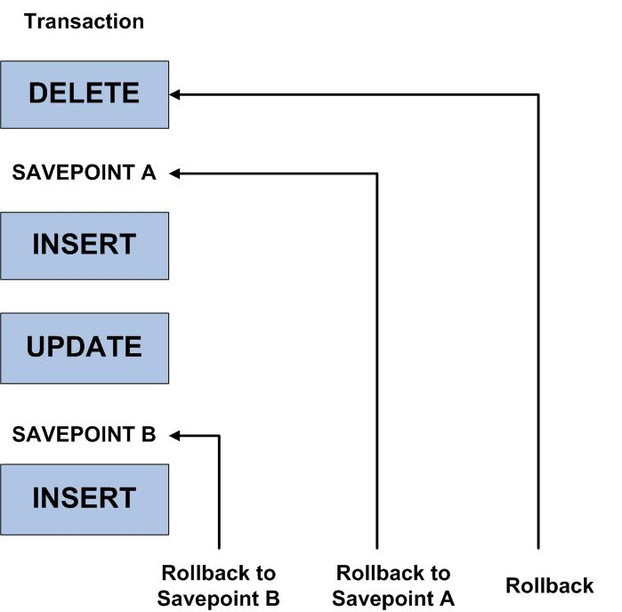
Controlling transaction

Slide 40
SAVEPOINTS
UPDATE employees SET salary = 7000 WHERE last_name = 'Banda';
SAVEPOINT banda_sal;
UPDATE employees SET salary = 12000 WHERE last_name = 'Greene';
SAVEPOINT greene_sal;
SELECT SUM(salary) FROM employees;
ROLLBACK TO SAVEPOINT banda_sal;
UPDATE employees SET salary = 11000 WHERE last_name = 'Greene';
COMMIT;
ROLLBACK WILL UNDO UPDATE OF GREENE’S SALARY TO 12000 THEN THE UPDATE
TO 11000 WILL BE EXECUTED

Slide 41
ROLLBACK transaction
ROLLBACK
Oracle undoes all transaction changes using the undo tablespace or rollback segments
Oracle releases all the transaction’s locks of data
The transaction ends
ROLLBACK to SAVEPOINT
Oracle rolls back only the statements run after the savepoint.
Oracle preserves the specified savepoint, but all savepoints that were established after the specified one are lost
Oracle releases all table and row locks acquired since that savepoint

Slide 42
State of the Data Before COMMIT or ROLLBACK
The previous state of the data can be recovered.
The current user can review the results of the DML operations by using the SELECT statement.
Other users cannot view the results of the DML statements by the current user.
The affected rows are locked
Other users cannot change the data within the affected rows.

Slide 43
State of the Data after COMMIT
Data changes are made permanent in the database.
The previous state of the data is permanently lost.
All users can view the results.
Locks on the affected rows are released; those rows are available for other users to manipulate.
All savepoints are erased.

Slide 44
Data Definition Language
Any DDL statement performs a COMMIT
A DDL statement is a Data Definition Language statement, such as CREATE, ALTER or DROP

Slide 45
Sub-queries

Slide 46



Using a Subquery to Solve a Problem
Which games have a value greater than Jaws?
Main query:
Which games have a value greater than Soma?
Subquery:
What is the price of Soma?

Slide 47
Subquery Syntax
The subquery (inner query) executes once before the main query (outer query).
The result of the subquery is used by the main query.
SELECT select_list
FROM table
WHERE expr operator
(SELECT select_list
FROM table);
Notes:
Subquery Syntax
A subquery is a SELECT statement that is embedded in a clause of another SELECT statement. You can build powerful statements out of simple ones by using subqueries. They can be very useful when you need to select rows from a table with a condition that depends on the data in the table itself.
You can place the subquery in a number of SQL clauses, including the following:
WHERE clause
HAVING clause
FROM clause
In the syntax:
operator includes a comparison condition such as >, =, or IN
Note: Comparison conditions fall into two classes: single-row operators (>, =, >=, <, <>, <=) and multiple-row operators (IN, ANY, ALL).
The subquery is often referred to as a nested SELECT, sub-SELECT, or inner SELECT statement. The subquery generally executes first, and its output is used to complete the query condition for the main (or outer) query.

Slide 48
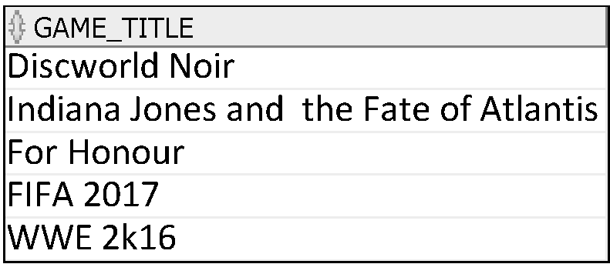
Using a Subquery
SELECT game_title
FROM mm_game
WHERE game_price >
(SELECT game_price
FROM mm_game
WHERE game_title = 'Jaws');
9
Notes:
Using a Subquery
The outer query takes the result of the inner query and uses this result to display all the games with a value greater than that amount.

Slide 49
Single-Row Subqueries
Return only one row from the sub-query
Use single-row comparison operators
Operator | Meaning
= | Equal to
> | Greater than
>= | Greater than or equal to
< | Less than
<= | Less than or equal to
<> | Not equal to
Notes:
Single-Row Subqueries
A single-row subquery is one that returns one row from the inner SELECT statement. This type of subquery uses a single-row operator. The slide gives a list of single-row operators.
Example
Display the employees whose job ID is the same as that of employee 141:
SELECT last_name, job_id
FROM employees
WHERE job_id =
(SELECT job_id
FROM employees
WHERE employee_id = 141);

Slide 50
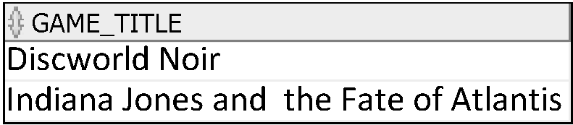
Executing Single-Row Subqueries
SELECT game_title
FROM mm_game
WHERE game_price >
(SELECT game_price
FROM mm_game
WHERE game_title = ‘Soma')
AND game_type_id =
(SELECT game_type_id
FROM mm_game
WHERE game_id = 1);
9
1
Notes:
Executing Single-Row Subqueries
A SELECT statement can be considered as a query block. The example in the slide displays employees whose job ID is the same as that of employee 141 and whose salary is greater than that of employee 143.
The example consists of three query blocks: the outer query and two inner queries. The inner query blocks are executed first, producing the query results ST_CLERK and 2600, respectively. The outer query block is then processed and uses the values that were returned by the inner queries to complete its search conditions.
Both inner queries return single values (ST_CLERK and 2600, respectively), so this SQL statement is called a single-row subquery.
Note: The outer and inner queries can get data from different tables.

Slide 51
Multiple-Row Subqueries
Return more than one row form the sub-query
Use multiple-row comparison operators
Operator | Meaning
IN | Equal to any member in the list
ANY | Compare value to each value returned by the subquery
ALL | Compare value to every value returned by the subquery
Notes:
Multiple-Row Subqueries
Subqueries that return more than one row are called multiple-row subqueries. You use a multiple-row operator, instead of a single-row operator, with a multiple-row subquery. The multiple-row operator expects one or more values:
SELECT last_name, salary, department_id
FROM employees
WHERE salary IN (SELECT MIN(salary)
FROM employees
GROUP BY department_id);
Example
Find the employees who earn the same salary as the minimum salary for each department.
The inner query is executed first, producing a query result. The main query block is then processed and uses the values that were returned by the inner query to complete its search condition. In fact, the main query appears to the Oracle server as follows:
SELECT last_name, salary, department_id
FROM employees
WHERE salary IN (2500, 4200, 4400, 6000, 7000, 8300, 8600, 17000);

Slide 52
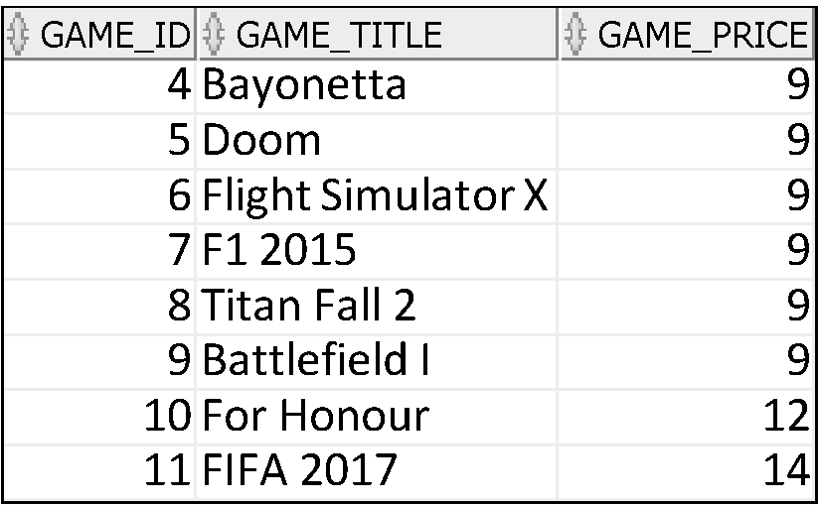
Using the ANY Operator in Multiple-Row Subqueries
The ANY operator (and its synonym, the SOME operator) compares a value to each value returned by a subquery and returns a row if meets the condition for any of them.
SELECT game_id, game_title, game_price
FROM mm_game
WHERE game_price < ANY
(SELECT game_price
FROM mm_game
WHERE game_type_id=1)
AND game_type_id <> 1;
10,9,15
Notes:
Multiple-Row Subqueries (continued)
The ANY operator (and its synonym, the SOME operator) compares a value to each value returned by a subquery. The slide example displays employees who are not IT programmers and whose salary is less than that of any IT programmer. The maximum salary that a programmer earns is $9,000.
<ANY means less than the maximum. >ANY means more than the minimum. =ANY is equivalent to IN.

Slide 53
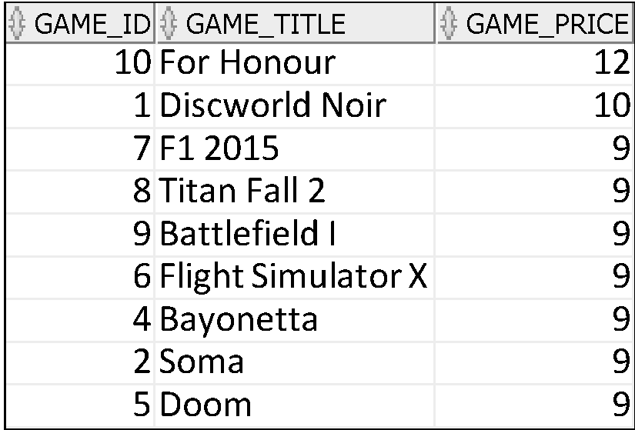
Using the ALL Operator in Multiple-Row Subqueries
The ALL operator compares a value to every value returned by a subquery and returns a row only if it meets the condition for all of them
SELECT game_id, game_title, game_price
FROM mm_game
WHERE game_price < ALL
(SELECT game_price
FROM mm_game
WHERE game_type_id=5)
AND game_type_id <> 5;
14,15
Notes:
Multiple-Row Subqueries (continued)
The ALL operator compares a value to every value returned by a subquery. The slide example displays employees whose salary is less than the salary of all employees with a job ID of IT_PROG and whose job is not IT_PROG.
>ALL means more than the maximum, and <ALL means less than the minimum.
The NOT operator can be used with IN, ANY, and ALL operators.

Slide 54
Exists, Not Exists
Syntax
WHERE EXISTS ( subquery );
WHERE NOT EXISTS (subquery);
If the subquery returns at least one record in its result set, the EXISTS clause will evaluate to true and the EXISTS condition will be met.
If the subquery does not return any records, the EXISTS clause will evaluate to false and the EXISTS condition will not be met.

Slide 55
SELECT game_id, game_title, game_price
FROM mm_game
WHERE EXISTS (select lastname from mm_customer where substr(lastname,2,1)=substr(game_title,2,1));

Slide 56
Exists, Not Exists
Syntax
WHERE NOT EXISTS (subquery);
If the subquery returns at least one record in its result set, the NOT EXISTS clause will evaluate to true and the NOT EXISTS condition will be met.

Slide 57
Guidelines for Using Subqueries
Enclose subqueries in parentheses (…..)
Place subqueries on the right side of the comparison condition.
Use single-row operators with single-row subqueries, and use multiple-row operators with multiple-row subqueries.
Notes:
Guidelines for Using Subqueries
A subquery must be enclosed in parentheses.
Place the subquery on the right side of the comparison condition for readability.
With Oracle8i and later releases, an ORDER BY clause can be used and is required in the subquery to perform Top-N analysis.
Prior to Oracle8i, however, subqueries could not contain an ORDER BY clause. Only one ORDER BY clause could be used for a SELECT statement; if specified, it had to be the last clause in the main SELECT statement.
Two classes of comparison conditions are used in subqueries: single-row operators and multiple-row operators.

Slide 58
UPDATE using a sub-query
Suppose we want to increase the price of all games in the horror game_type by 10%.
UPDATE MM_game
SET game_Price = 1.1 * game_PRICE
WHERE game_TYPE_ID IN (
SELECT game_TYPE_ID
FROM MM_game_TYPE
WHERE UPPER(game_TYPE_DESCRIPTION)=‘COMBAT‘
);

Slide 59
UPDATE using a sub-query
Suppose we want to set the price of games with IDs of 1, 2, 3, 4 to be the same as the price of game 10?
UPDATE MM_game
SET game_Price =
(SELECT game_PRICE FROM MM_game
WHERE game_ID=10)
WHERE game_ID BETWEEN 1 AND 4;

Slide 60
DELETE using a sub-query
DELETE FROM MM_RENTAL
WHERE game_ID IN
(SELECT game_ID
FROM MM_game
WHERE game_TYPE_ID IN
(SELECT game_TYPE_ID
FROM MM_game_TYPE
WHERE UPPER(game_TYPE_DESCRIPTION)=‘COMBAT')
);

